Slide 1
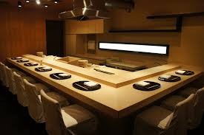
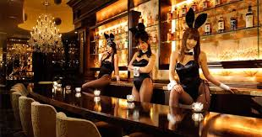
SINCA Online Auction : No. ##
Photos or any other way（incl. visual) to explain your offering.
Pro organizer of “Settai” | “Comfortable night in Ginza with good conversation” for your customers ( clients / family / friends
Sponsor | XXXX Your real name, And/or nickname if preferable
Number of People | 1-4 people.
Date, Timing | Weeknights
Time, Duration | Between 6:00 pm to 10:00 pm 2 hrs or so, with 2nd round possible
Location | Ginza area
Starting Price | 10,000 yen (all food and drink inclusive)
Outline | You can learn Manner of Entertainment ( 接待) from offer to seeing off Selection of venue food and beverage How to create comfortable atmosphere You can enjoy Good food and beverage 2nd round* will be organized upon your request
Note that the service will follow the New Normal way with COVID-19.

